Slide 1
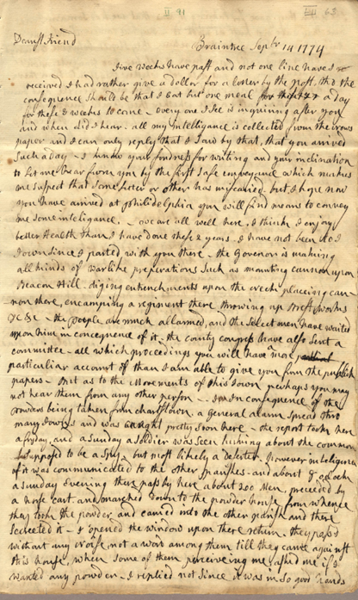
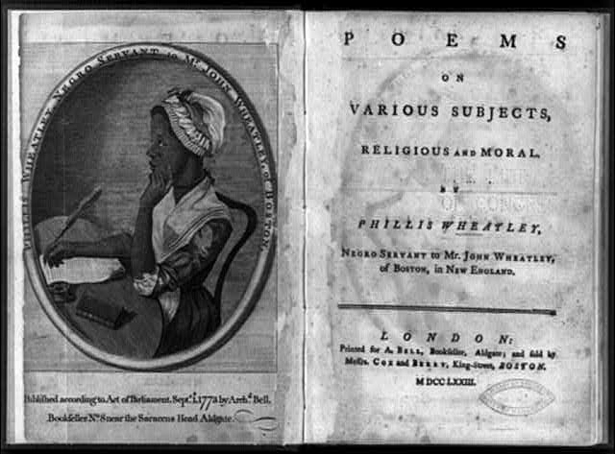
It’s elementary my dear: primary sources in the elementary classroom
Dr. Tammara Purdin
Dr. Kacie Nadeau
Carol LaVallee, M.Ed
April 4, 2019

Slide 3
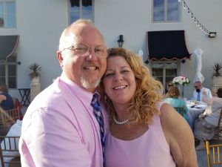
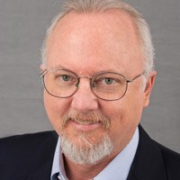
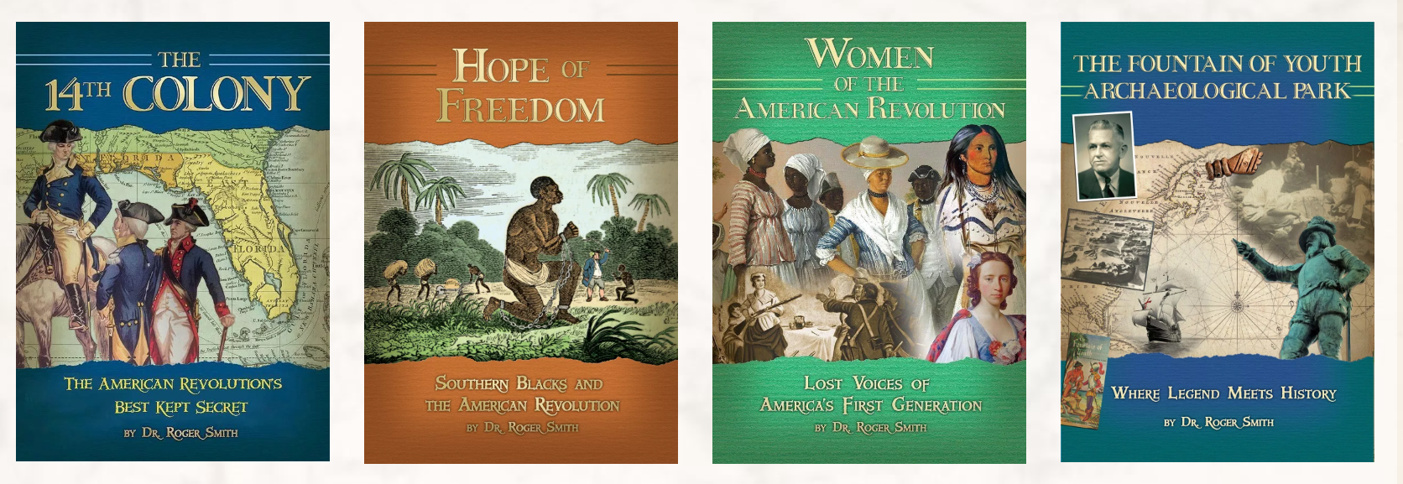
Dr. Roger Smith
http://www.colonialra.com/

Slide 4

Era of Accountability
Effects of high-stakes testing
Marginalization of elementary social studies
Inadequate instructional time and resources
Lack of professional district level support
Integrative/interdisciplinary approaches

Slide 5
Common Core
Florida Standards
Higher order thinking skills
Informational texts
  Primary and secondary sources
Text structures (chronology, cause & effect, compare/contrast, etc.)
Research
  Citing and evaluating multiple sources
  Corroborating evidence and drawing conclusions
Social studies content during reading instruction
Reinforcing literacy skills during social studies instruction
Visual literacy
  Interpreting graphs, data…
Language Arts Florida Standards (LAFS)
Mathematics Florida Standards
(MAFS)

Slide 6
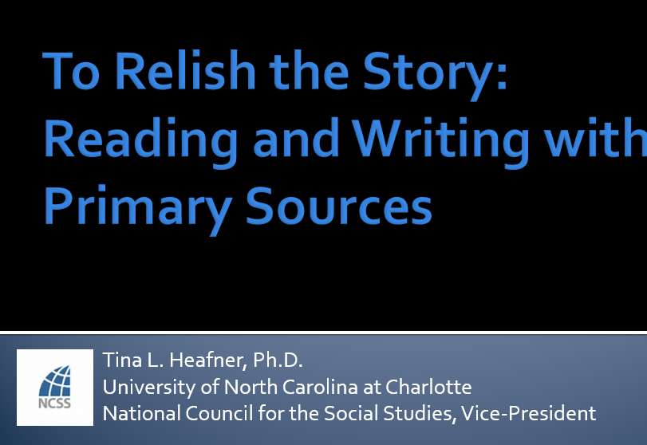
Who is doing the thinking?
Teacher-Given Thinking
Creativity is lost in comprehension through authoritiative thinking
Arrived at Thinking
Forged reasoning is repeated from an authority
Personally derived insights have longevity, greater applicability, and versatility in new contexts
Creativity of thought is currated through reasoning and sense-making

Slide 7
Why are social studies sources so difficult?
Comprehension
Motivation
Dr. Tina Heafner, Sources Conference, January 28, 2018

Slide 8
How can historical thinking broaden perceptions of historical events?

Slide 9

Power of production in the social studies
“Social studies teachers must find new methods to actively engage students in historical events and facilitate critical thinking. Teachers, especially at the middle school level, must develop hands-on tools that enable students to express their opinions and understandings” (Bickford, 2010).
“A central historical question focuses students‘ attention and transforms the act of reading into a process of active inquiry. Historical questions share two key characteristics : 1 ) they are open multiple interpretations; 2) they direct students to the historical record, rather than to their philosophical or moral beliefs” (Reisman & Wineburg, 2012).

Slide 10
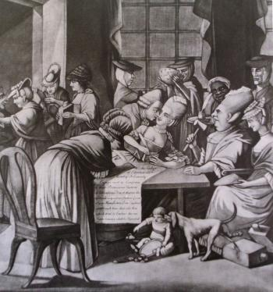
Practice Historical Thinking Skills
Close read: What do you see? List people, objects, and activities.
Evidence of symbolism or exaggeration?
Sourcing: When, where, and by whom was the source created?
Context:
The Edenton Tea Party was one of the earliest organized women’s political actions in United States history. On October 25, 1774, Mrs. Penelope Barker organized, at the home of Mrs. Elizabeth King, fifty-one women in Edenton, North Carolina.
News of the Edenton Tea Party quickly reached Britain. During the 1770s, political resistance was common. But an organized women’s movement was not. So, the Edenton Tea Party shocked the Western world. From England, in January 1775, Arthur Iredell wrote his brother, James Iredell, describing England’s reaction to the Edenton Tea Party. According to Arthur Iredell, the incident was not taken seriously because it was led by women. He sarcastically remarked, “The only security on our side … is the probability that there are but few places in America which possess so much female artillery as Edenton.” The Edenton women were also satirized in a political cartoon published in London in March 1775. Even though the Edenton Tea Party was ridiculed in England, it was praised in the colonies. The women of Edenton represented American frustrations with English monarchical rule and the need for American separation and independence.
https://northcarolinahistory.org/encyclopedia/edenton-tea-party/
Title: A Society of Patriotic Ladies
By: Philip Dawe
Date: March 25, 1775.
This cartoon is a satirical interpretation of the Edenton Tea Party and appeared in a London newspaper.
Image courtesy of the North Carolina Office of Archives and History, Raleigh, NC.

Slide 11
BREAK TIME! (5 mins)

Slide 12
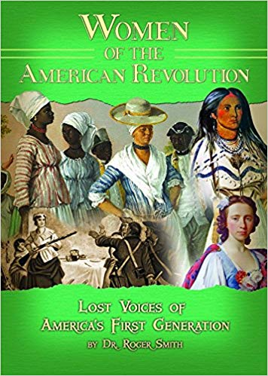
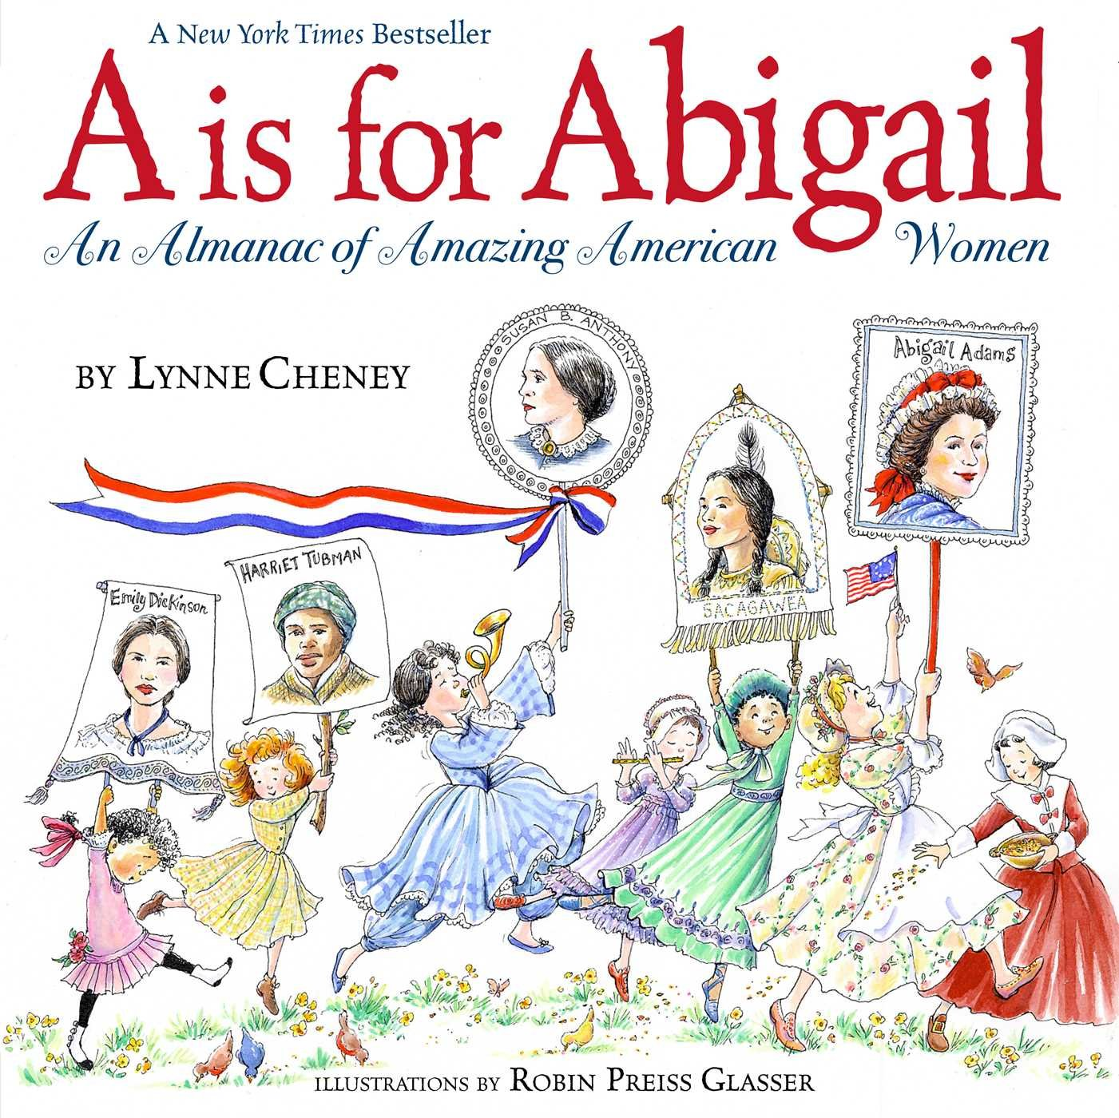
Women in American history
Florida statute: §1003.42, F.S.
Members of the instructional staff of the public schools, subject to the rules of the State Board of Education and the district school board, shall teach efficiently and faithfully, using the books and materials required that meet the highest standards for professionalism and historical accuracy, following the prescribed courses of study, and employing approved methods of instruction, the following:
(q) The study of women’s contributions to the United States.

Slide 13
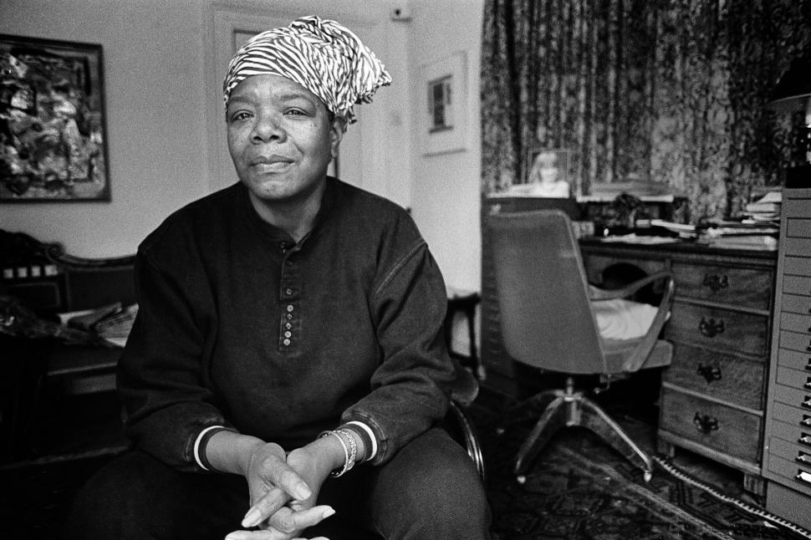
Maya angelou poet, storyteller, activist, autobiographer
Essential Questions:
How do primary sources (photographs) show what role women have?
How are women authors important to history?
How can a timeline show important events in history?
What do you see?
Who is in the photograph?
What might she do for a job? How do you know?
How does background evidence support your claims?
Building interdisciplinary literacy
https://www.poetryfoundation.org/poets/maya-angelou

Slide 14
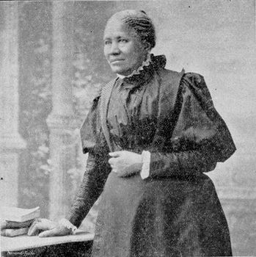
Frances Ellen Watkins poet, fiction writer, journalist, activist
What do you see?
Who is in the photograph?
What might she do for a job? How do you know?
What similarities exist between this image and the image of Maya Angelo?
https://www.blackpast.org/african-american-history/1875-frances-ellen-watkins-harper-great-problem-be-solved/

Slide 15
Phillis Wheatley
Poet, slave
What is different about this image than that of Maya and Frances?
What do each of the images have in common?
What is the job or contribution of this woman?
Title: Frontis.: portrait of Phyllis Wheatley, and title p. of Wheatley, Poems on Various Subjects..., London, 1773]
Created / Published: 1773.
Medium: 1 print : engraving.
Repository: Library of Congress Prints and Photographs Division Washington, D.C. 20540 USA
Digital Id: cph 3b04682 //hdl.loc.gov/loc.pnp/cph.3b04682

Slide 16
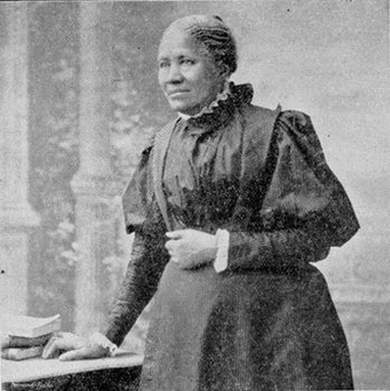
Build a timeline
Frances Ellen Watkins: September 24, 1825 to February 22, 1911
Phyllis Wheatley: May 8, 1753 to December 5, 1784
Maya Angelou: April 4, 1928 to May 28, 2015

Slide 17
What should be the title for this timeline?
Think of a woman you know and the job they have. Draw a picture of this woman doing this job. Remember to use background evidence in your picture that helps the audience recognize this occupation.
Phyllis Wheatley: May 8, 1753 to December 5, 1784
Frances Ellen Watkins: September 24, 1825 to February 22, 1911
Maya Angelou: April 4, 1928 to May 28, 2015

Slide 18
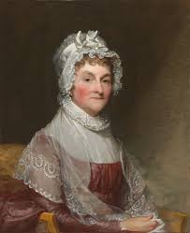
Abigail Adams and the
American revolution
Essential Questions:
How does a letter (primary source) show how people lived a long time ago?
What sacrifices were made in times of war?
Read the first six letters A-F (Abigail Adams-First Ladies).
List examples of something special Abigail does.
List other examples of women’s accomplishments.
https://www.nga.gov/collection/art-object-page.42934.html

Slide 19
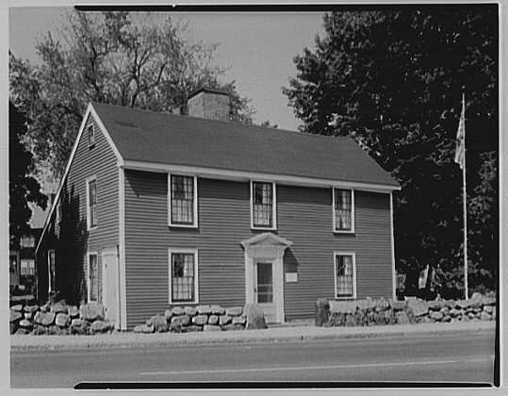
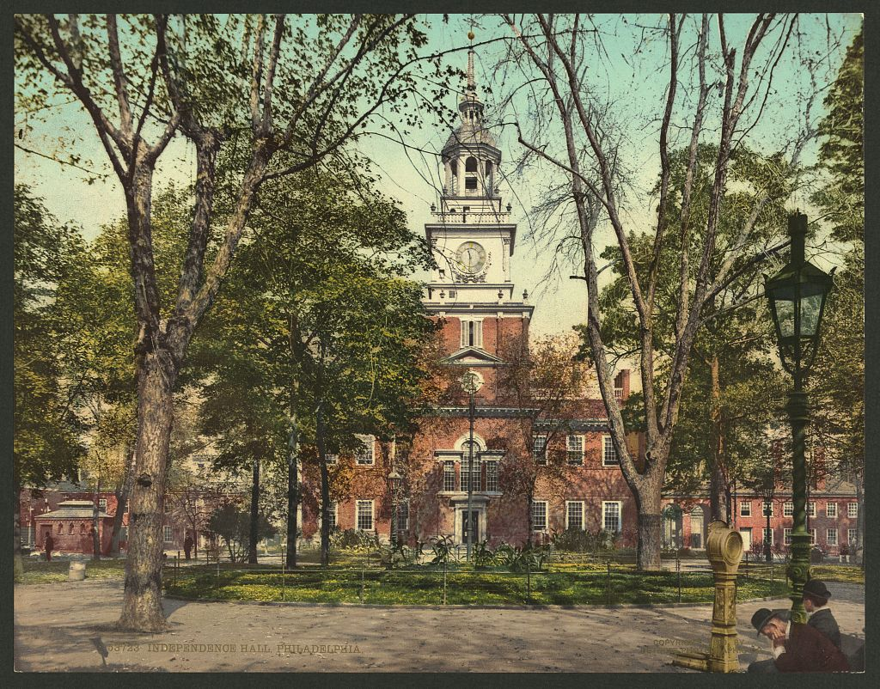
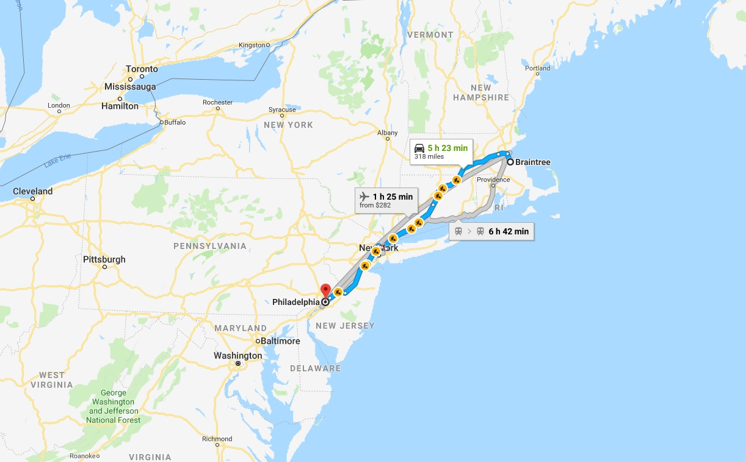
Braintree to Philadelphia:
Adams’ Home to continental congress
https://www.loc.gov/item/2008679522/
https://www.loc.gov/item/gsc1994010098/PP/

Slide 20
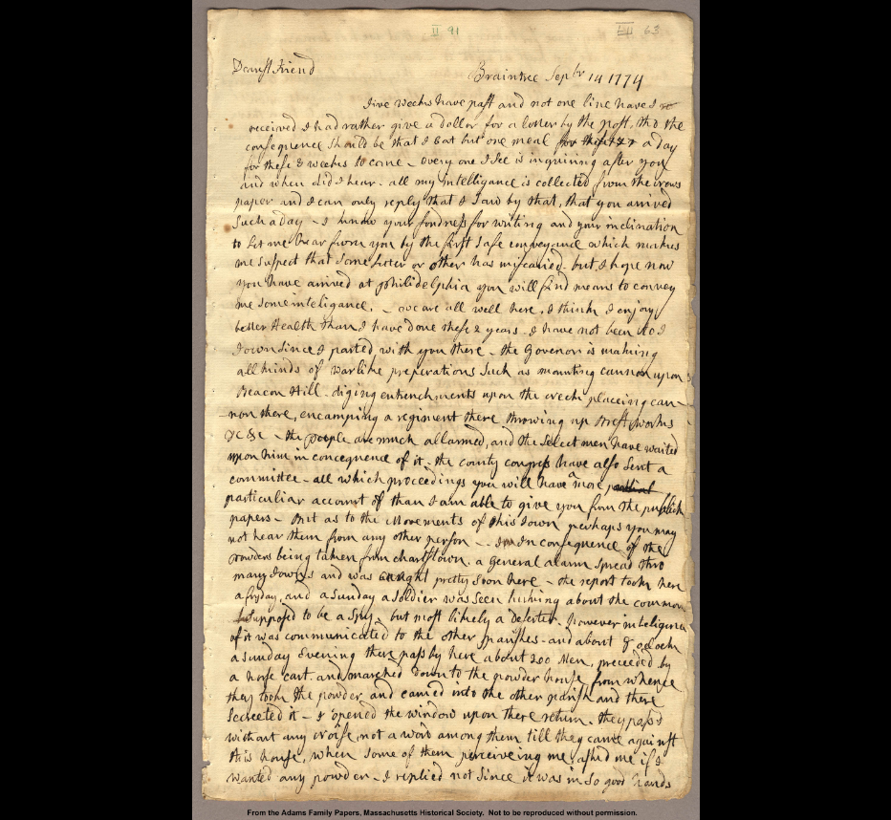
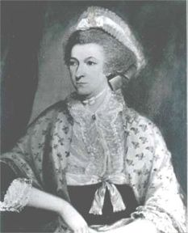
http://www.firstladies.org/biographies/firstladies.aspx?biography=2
MODIFIED:
Five weeks have past since I have heard from you. I would pay a $1.00 to hear from you, but then I would be only able to eat one meal a day for the next three weeks. Everyone is asking about you and what I have heard from you. I have only learned about you in the newspaper, and have told people I say that you have arrived. I know you love to write and will write me as soon as you feel it is safe. I hope you have arrived in Philadelphia and will write to me soon.

Slide 21
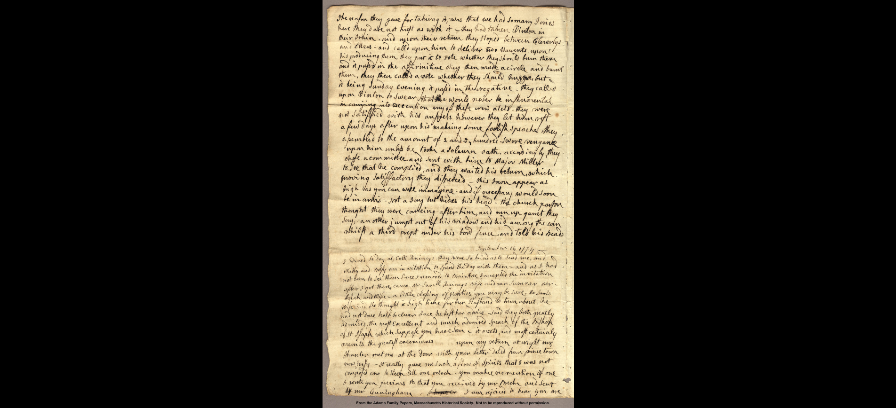
September 16, 1774 (Excerpt)
I am rejoiced to hear you are well; I want to know many more perticuliars than you wrote me, and hope soon to hear from you again. I dare not trust myself with the thought of how long you may [illegible] perhaps be absent. I only count the weeks already past, and they amount to 5. I am not so lonely as I should have been, without my two Neighbours. We make a table full at meal times, all the rest of their time they spend in the office. Never were two borders persons who gave a family less trouble than they do. It is at last determined that Mr. Rice keep the School here. Indeed he has kept ever since he has been here, but not with any expectation that He should be continued, but the people finding no small difference between him and his predecessor chose he should be continued. I have not sent Johnny. He goes very steadily to Mr. Thaxter who I believe takes very good care of him, and as they seem to have a likeing to each other believe it will be best to continue him with him. However when you return we can then consult what will be best…
MODIFIED:
I am so happy to hear you are well. I want to know more about what is going on than what you wrote me in your last letter and hope to hear from you again. I can’t think about how long you will be gone. I have only counted the weeks that have past, and it has been five weeks. I am not as lonely because I have two neighbors. We eat meals together and the rest of the time they spend in the office. They rarely bother me. Mr. Rice is teaching at a school here and has continued to do so even if people see no difference between him and the last teacher. I have not sent Johnny to school. He goes often to Mr. Thaxter who I believe takes very good care of him. However, when you return we can then consult what will be best…

Slide 22
Contextualization
Close reading
Think about women you know in your life. What do these women do for you? Are any of those tasks the same as Abigail?
Recall a time when you or someone you know had to travel away from the families.
Is Abigail upset? Why?
What does Abigail want to know?
How many days later was the second letter received?
Is the second letter different from the first? Why or why not?
Is Abigail still upset? How do you know?
How long has John been gone?
What has been happening around her?
What evidence supports that activity?
Historical empathy: making connections

Slide 23
BREAK TIME! (5 mins)

Slide 24

Women in
American history
Lesson Debrief
How can these sources/strategies be useful in your classroom?
What did you learn today that you didn’t know before?
What kinds of sources (primary or secondary) will you bring back to your classroom? Where will you find them?

Slide 25
Welcome Back: Dr. Roger Smith
http://www.colonialra.com/

Slide 26

Lesson Plan #1 Debrief
AT YOUR TABLES:
Share your “Reflections Worksheet”
Share evidence of your lesson
Time permitting: Visit with a teacher who implemented the same lesson as you and share reflections
What does FLCHE need to know?

Slide 27

FLORIDA COUNCIL FOR HISTORY EDUCATION
Lessons uploaded weekly and access to Reflection Template:
www.flche.net
Like us on Facebook:
“FLCHE-TPS”
This workshop is sponsored in part by the Library of Congress Teaching with Primary Sources Eastern Region Program, coordinated by Waynesburg University.

