Slide 1
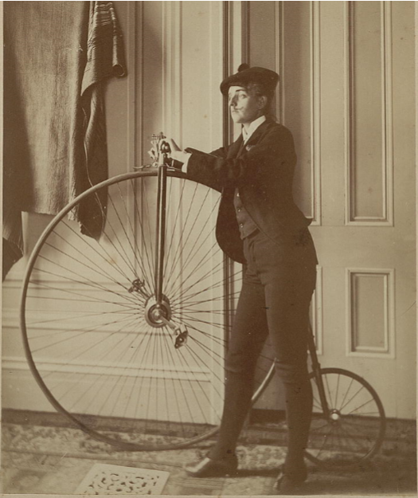
Welcome! Please use a sticky note and make one or more comments or pose a question based on the photo, like you would on social media. You may respond to other comments and questions too.
https://memory.loc.gov/ammem/awhhtml/awpnp6/johnston_coll.html

Slide 2
An Investigation on Herstory in American History
Contextualizing & sourcing, using Loc.gov

Slide 3
However, students struggle because they have been trained to find a "right" answer.
Essential Question: How did women make an impact in history?
Historical thinking promotes abstract higher level reasoning by not looking for a "right" answer. There is rarely one simple answer.
Notice how broad the question is, allowing for multiple responses. There is no need for a right or wrong answer, as long as the student provides supporting evidence.

Slide 4
This activity is best suited for Grades K-5
This activity is best suited for the following content areas:
Art
English Language Arts
Social Studies

Slide 5
Our Goals
Understand contextualizing
Teach with primary sources
Locate primary and secondary sources on LOC website

Slide 6
TPS Foundation Objectives
By the end of this PD Activity, participants will be able to:
Justify conclusions about whether a source is primary or secondary depending upon the time or topic under study.
Describe examples of the benefits of teaching with primary sources.
Analyze a primary source using Library of Congress tools.
Analyze a set of related primary sources in order to identify multiple perspectives.
Demonstrate how primary sources can support at least one teaching strategy (e.g., literacy, inquiry-based learning, historical thinking, etc.).

Slide 7
What is Historical Thinking?
Based on the research of Wineburg, Martin, and Monte-Sano (2011), historical thinking contains certain actions such as:
…identify author’s position on a historical event; identify and evaluate author’s purpose in producing a document; evaluate a source’s believability/trustworthiness by considering genre, audience, and author’s purpose; use background information to draw more meaning from a document; infer historical context from documents; recognize that documents reflects one moment in a changing past; evaluate evidence/reasoning that the author uses to support claims; understand that language is used deliberately; establish truth by comparing documents to each other; and recognize disparities between two accounts. (SHEG, 2011 para. 2)

Slide 8
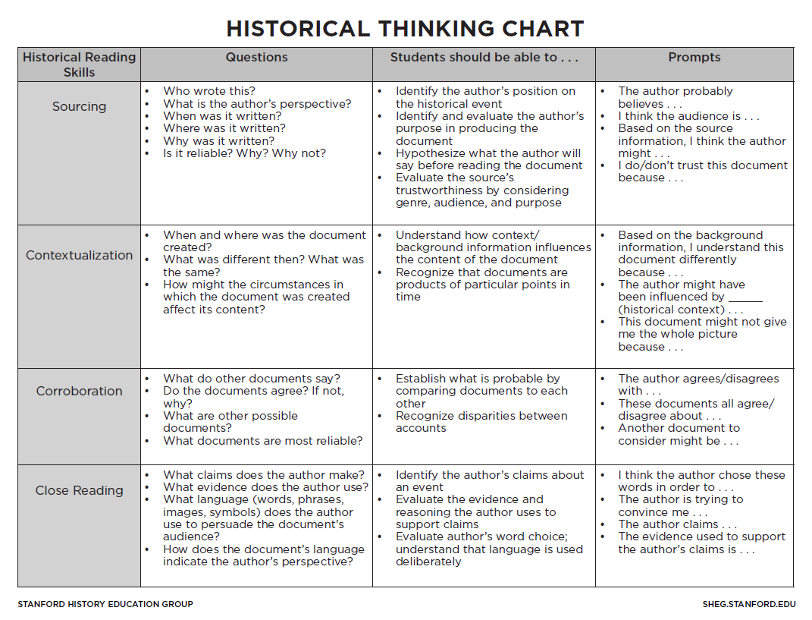
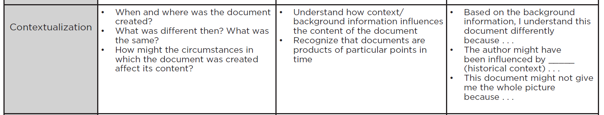

Slide 9
When and where was the document created?
Contextualizing
The strategy of contextualization involves inferring, using background knowledge, and recognition that the document(s) provide one small snapshot of a particular period of time.
What was different then? What was the same?
How might the circumstances in which created the document be different than what we think?

Slide 10

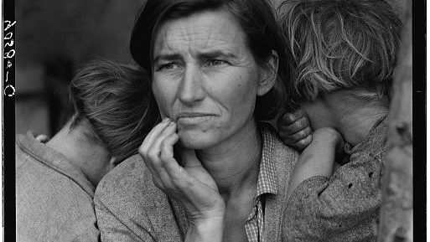
What was the first thing you noticed?

Slide 11
Let’s use LOC primary source organizers to analyze this photo

Slide 12
Is this a primary or secondary source? How do you know?
Migrant Mother
February or March of 1936
Dorothea Lange made in in Nipomo, California.
https://memory.loc.gov/ammem/awhhtml/awpnp6/migrant_mother.html

Slide 13
I saw and approached the hungry and desperate mother, as if drawn by a magnet. I do not remember how I explained my presence or my camera to her, but I do remember she asked me no questions. I made five exposures, working closer and closer from the same direction. I did not ask her name or her history. She told me her age, that she was thirty-two. She said that they had been living on frozen vegetables from the surrounding fields, and birds that the children killed. She had just sold the tires from her car to buy food. There she sat in that lean- to tent with her children huddled around her, and seemed to know that my pictures might help her, and so she helped me. There was a sort of equality about it. (From: Popular Photography, Feb. 1960).
http://www.loc.gov/rr/print/list/128_migm.html

Slide 14
Take a few minutes to read an excerpt from Library of Congress-American Woman website to learn about
awareness of the circumstances surrounding the situation of the image and how that compares to our interpretation of the picture
multiple contexts surrounding a single, well-known picture vividly illustrates the point that many factors shape the making and meaning of images.
http://memory.loc.gov/ammem/awhhtml/awpnp6/migrant_mother.html

Slide 15
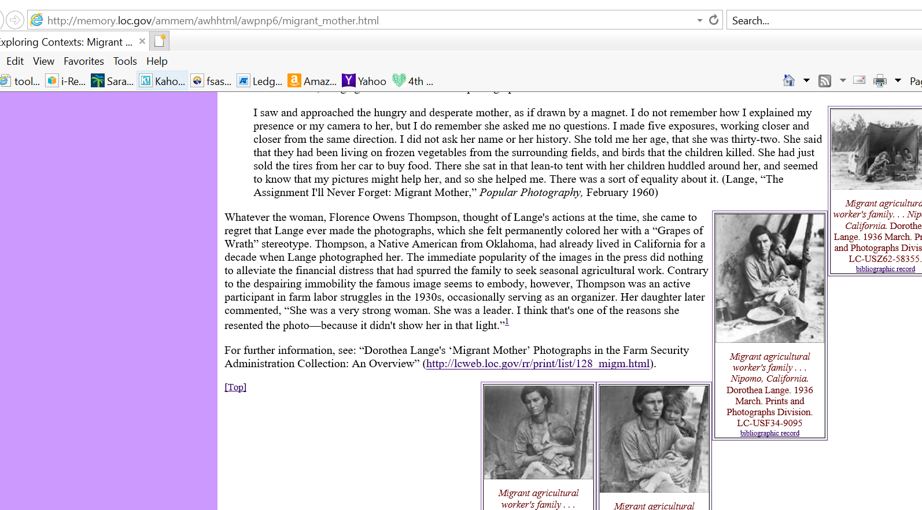
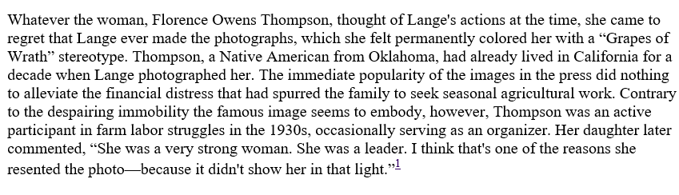

Slide 16
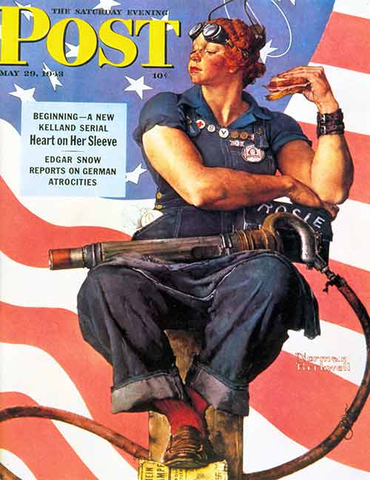
What is the first thing you notice?
Name 5 things you see?
What do you think this is?

Slide 17
Who created
this?
What was different then? What was the same?
What was the artist’s perspective?
When was it created/shared?
How might the circumstances in which the document was created affect its content?
Is it reliable? Why or why not?
https://www.nrm.org/rosie-the-riveter/

Slide 18
For more information on Rosie, watch this video discussing the evolution of Rosie: https://www.loc.gov/today/cyberlc/feature_wdesc.php?rec=3350

Slide 19
Essential Question: How did women make an impact in history?

Slide 20
What did you learn? What worked for you? What didn't work for you? What questions or concerns do you have? Is there anything else you want me to know about your experience today?

