Slide 1
The experiment called the constitution
Carol LaVallee, M.Ed, Library of Congress Ambassador
Dr. Tammara Purdin, Florida Council for History Education
https://tinyurl.com/FCSSLOC2018

Slide 2
Documents from the “Experiment” Library of Congress Primary Source Set- The Constitution
http://www.loc.gov

Slide 3
Florida Standards
Benchmark# | Description
LAFS.1112.RI.3.8 | Delineate and evaluate the reasoning in seminal U.S. texts, including the application of constitutional principles and use of legal reasoning (e.g., in U.S. Supreme Court majority opinions and dissents) and the premises, purposes, and arguments in works of public advocacy (e.g., The Federalist, presidential addresses).
LAFS.1112.RI.3.9 | Analyze seventeenth-, eighteenth-, and nineteenth-century foundational U.S. documents of historical and literary significance (including The Declaration of Independence, the Preamble to the Constitution, the Bill of Rights, and Lincoln’s Second Inaugural Address) for their themes, purposes, and rhetorical features.
LAFS.1112.W.3.9 | Draw evidence from literary or informational texts to support analysis, reflection, and research.
SS.2.C.3.1 | Identify the Constitution as the document which establishes the structure, function, powers, and limits of American government.
SS.3.C.1.3 | Explain how government was established through a written Constitution.
SS.5.A.5.10 | Examine the significance of the Constitution including its key political concepts, origins of those concepts, and their role in American democracy.
SS.5.C.1.2 | Define a constitution, and discuss its purposes.
SS.7.C.1.5 | Identify how the weaknesses of the Articles of Confederation led to the writing of the Constitution.
SS.7.C.2.5 | Distinguish how the Constitution safeguards and limits individual rights.
SS.8.A.3.11 | Analyze support and opposition (Federalists, Federalist Papers, AntiFederalists, Bill of Rights) to ratification of the U.S. Constitution.
SS.912.C.1.1 | Evaluate, take, and defend positions on the founding ideals and principles in American Constitutional government.
SS.912.C.3.1 | Examine the constitutional principles of representative government, limited government, consent of the governed, rule of law, and individual rights.
SS.912.C.3.11 | Contrast how the Constitution safeguards and limits individual rights.
SS.912.C.3.7 | Describe the role of judicial review in American constitutional government.
SS.912.W.2.18 | Describe developments in medieval English legal and constitutional history and their importance to the rise of modern democratic institutions and procedures.

Slide 4
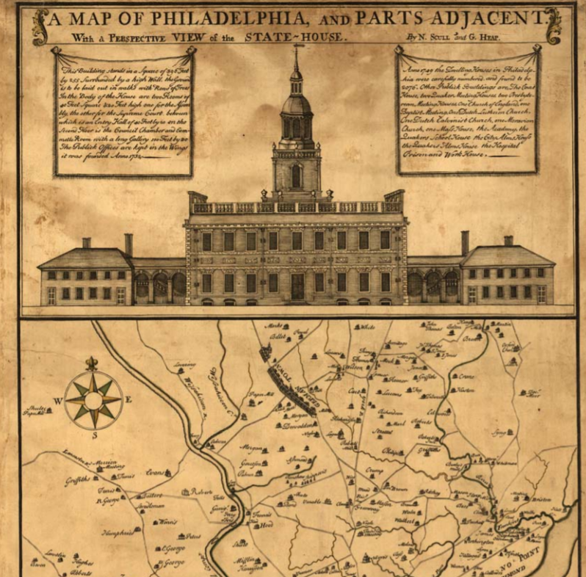
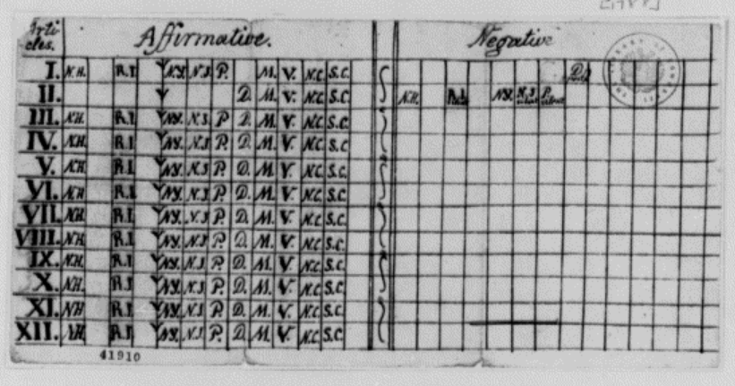
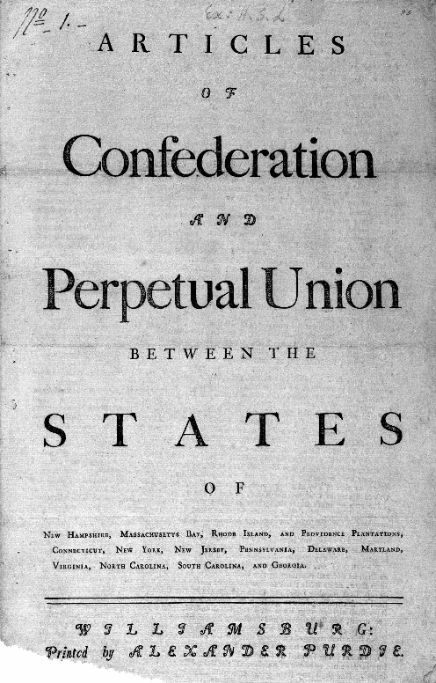
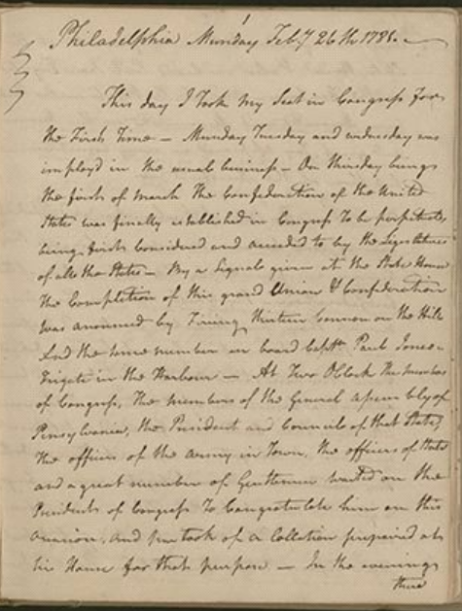
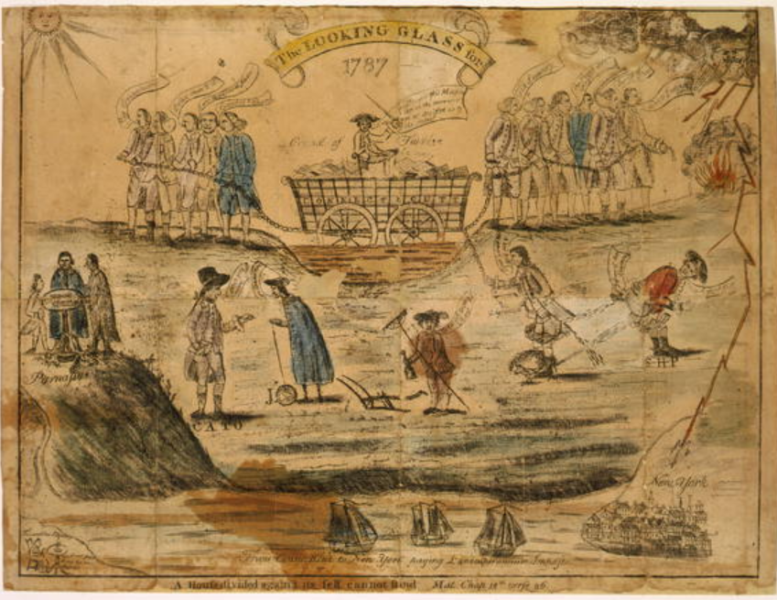
The “New Nation Experiment” Documents
Jefferson Chart of State Votes 1788
A map of Philadelphia 1752
Articles of Confederation 1777
Rodney Diary “13 Cannon Salute” 1781
The Looking Glass (FedvsAntifeds) 1787

Slide 5
Philadelphia in May 1787…
Fifty-five men from 12 different states gathered, intending to revise the Articles of Confederation.
Virginia Governor Edmund Randolph presented a plan prepared by James Madison.
The plan outlined a design for a new, centralized, strong national government.
Thus began the Constitutional Convention – the four-month process of secret argument, debate and compromise that produced a document that would soon be known in all corners of the globe: the Constitution of the United States.

Slide 6
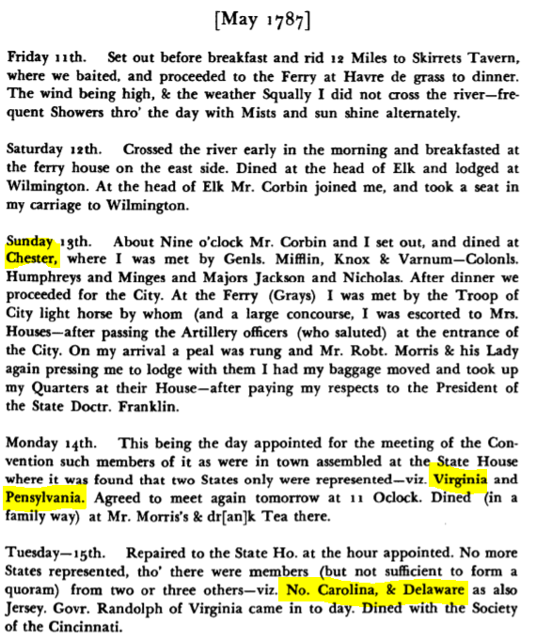
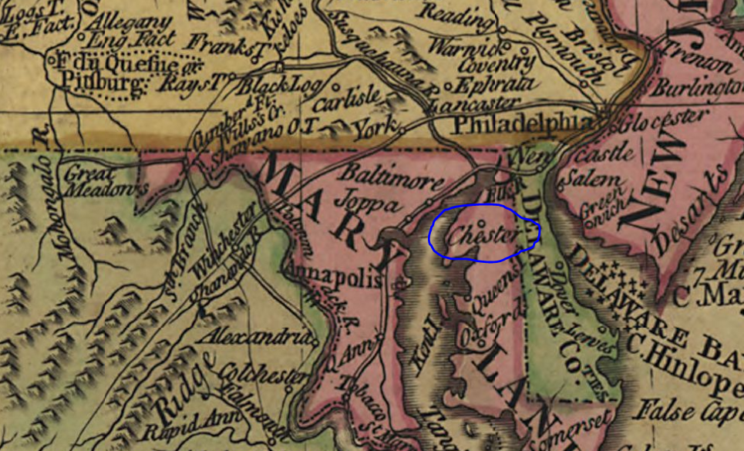
The Diaries of George Washington
Read George Washington’s diary entries. Pair these with a map of the nation from that time and check off the states as they arrive according to Washington’s entries.
The Diaries of George Washington. Vol. V. July 1786-December 1789
Bowles's new map of North America and the West Indies

Slide 7
George Washington Letter Introducing the Constitution
What democratic principles (e.g., separation of powers, compromise, and government responsibilities) does George Washington illustrate in this document?
Annals of Congress, formally known as The Debates and Proceedings in the Congress of the United States, cover the 1st Congress through the first session of the 18th Congress, from 1789 to 1824. http://memory.loc.gov/ammem/amlaw/ac001/intro3.html

Slide 8
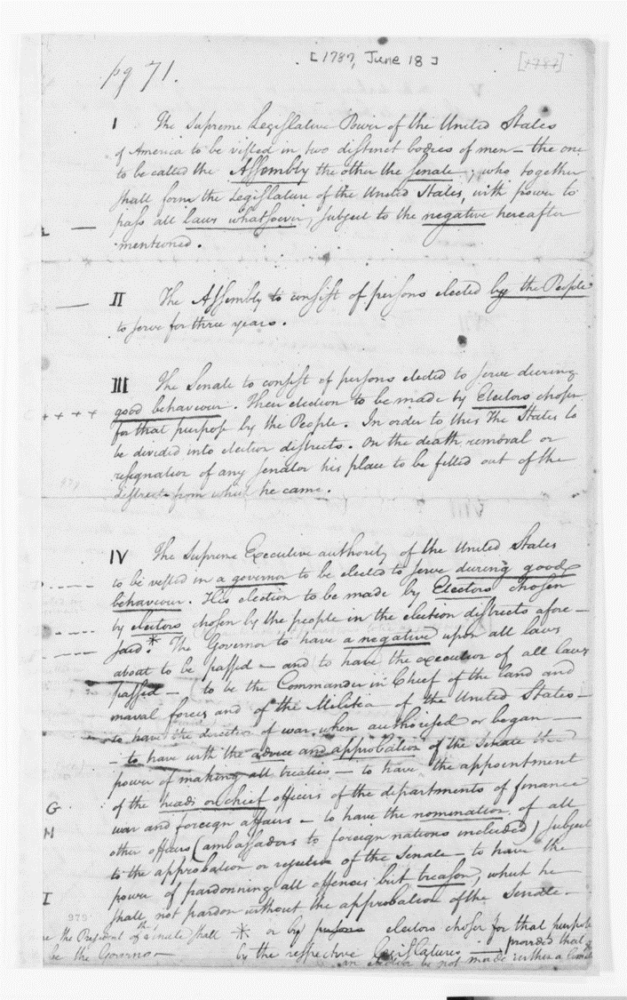
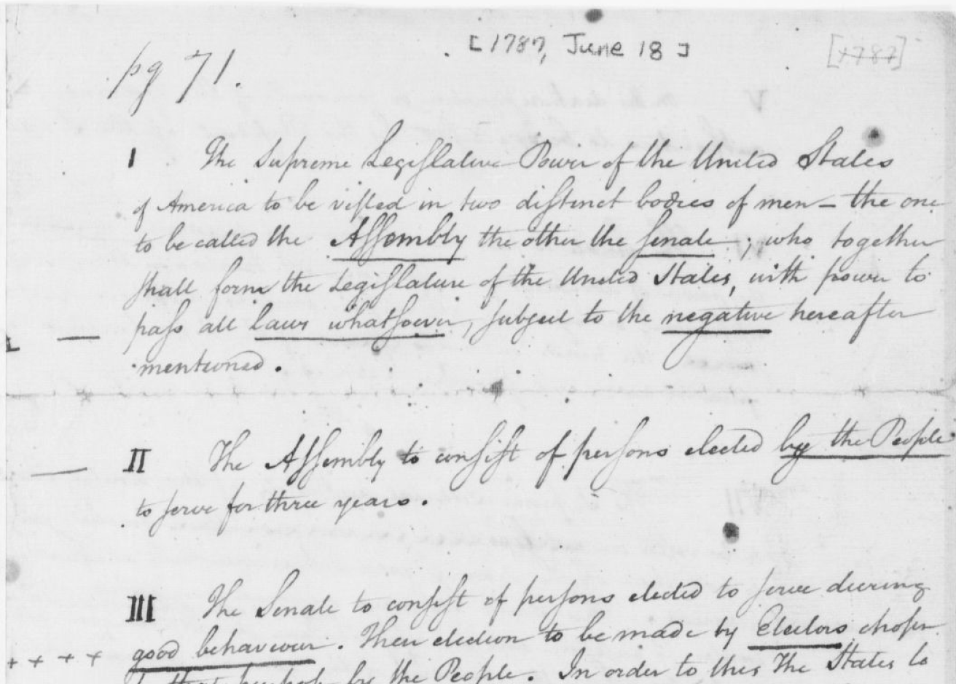
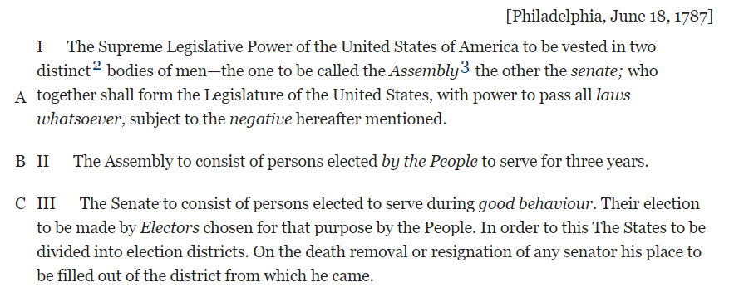
Not in Primary Source Set (see web link) https://founders.archives.gov/documents/Hamilton/01-04-02-0099
Constitutional Convention 1787 Plan of Government- Hamilton
What democratic principles can be found in what Hamilton underlined in his plan of government?
Transcript of Hamilton Plan of Govt 1787 https://founders.archives.gov/documents/Hamilton/01-04-02-0099
Constitutional Convention 1787- Plan of Government- Hamilton https://www.loc.gov/item/mss246120159/

Slide 9
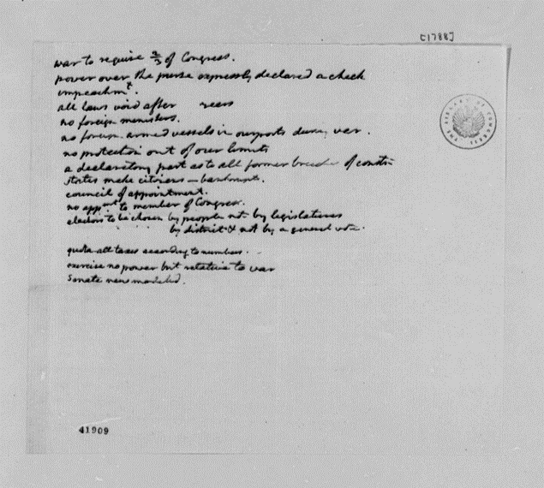
Jefferson’s notes on the Constitution, 1788
What do these notes tell us about Jefferson’s views on the Constitution and the newly formed government?
NO TRANSCRIPT
Jefferson's notes on the Constitution, 1788 http://hdl.loc.gov/loc.mss/mtj.mtjbib003996

Slide 10
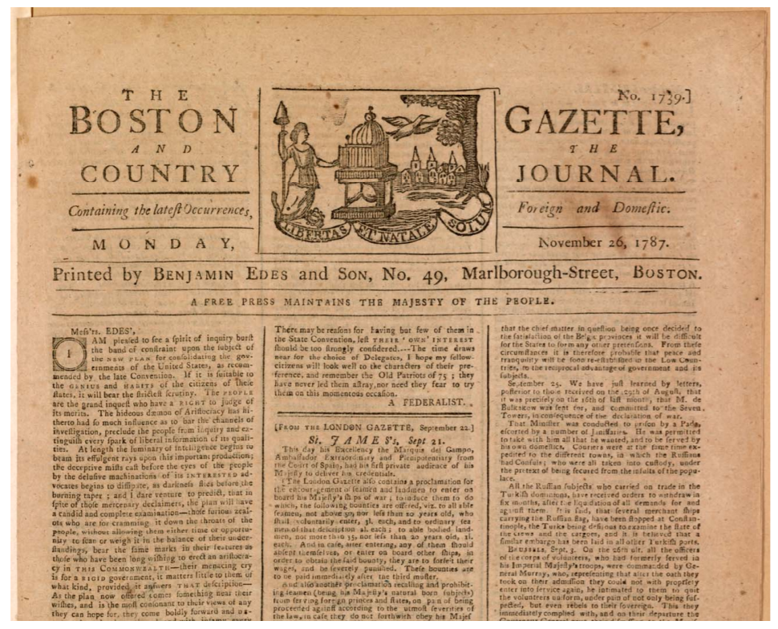
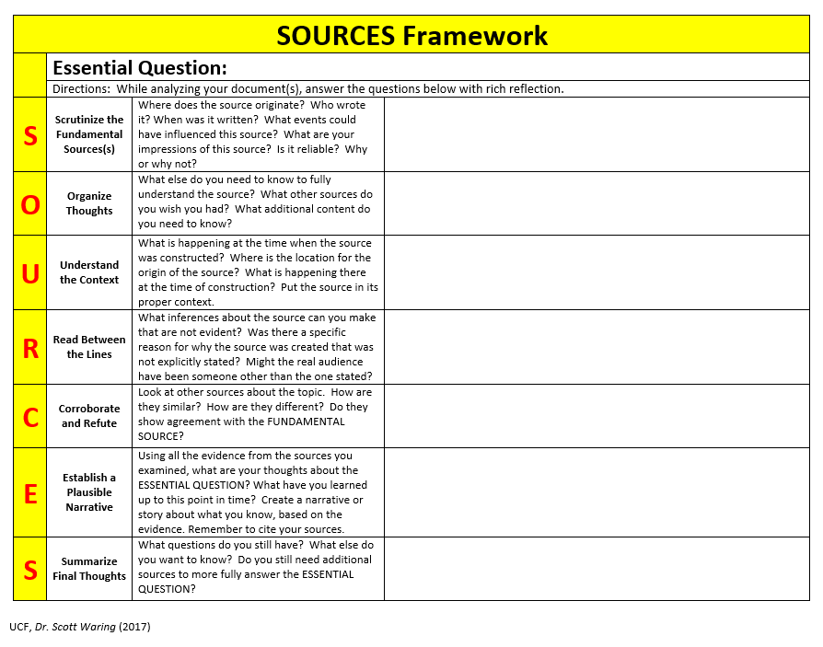
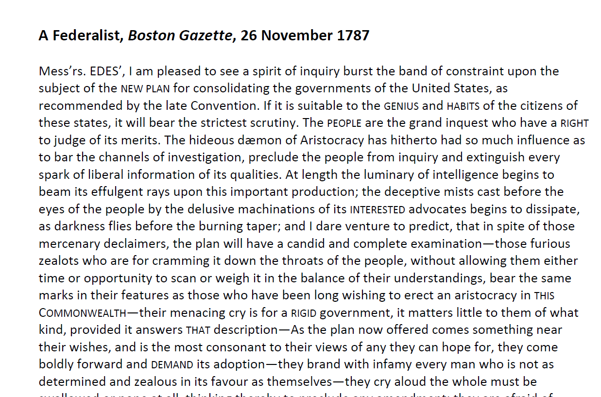
Boston Gazette, Nov 26, 1787
Opinion piece signed “A FEDERALIST”
S-scrutinize
0-organize
U-understand
R-read between lines
C-corroborate & refute
E-establish plausible narrative
S- summarize
Boston Gazette, Nov. 26, 1787 http://www.loc.gov/pictures/item/2004679481/

Slide 11
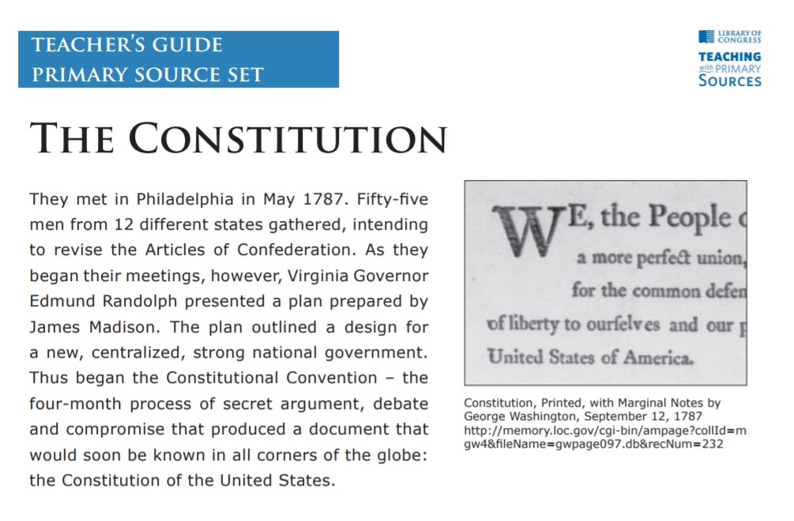
LOC Primary Source Set Teacher Guide - The Constitution

Slide 12
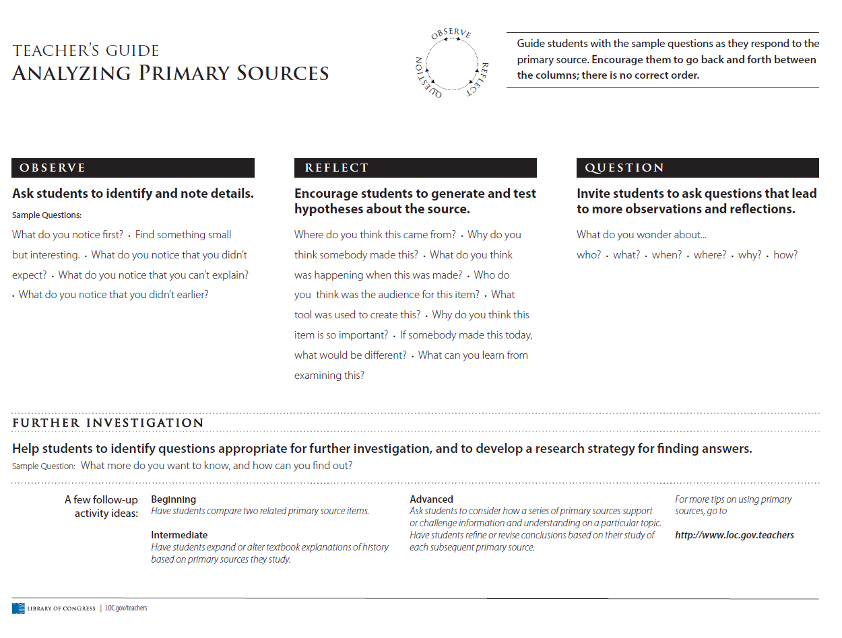
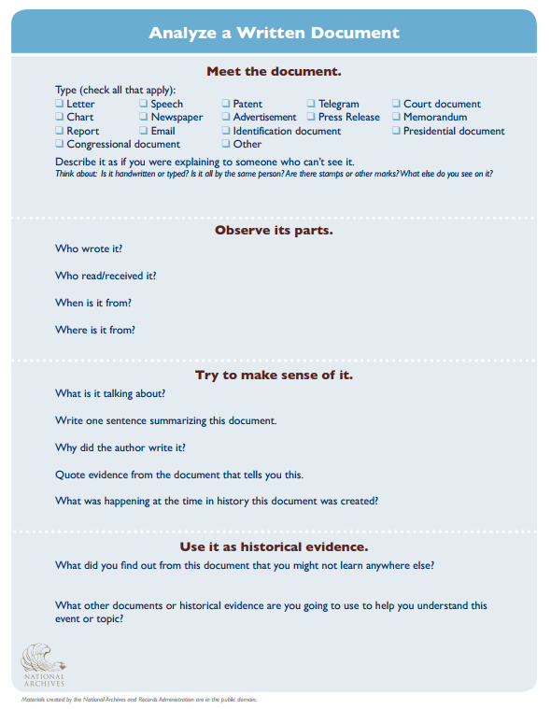
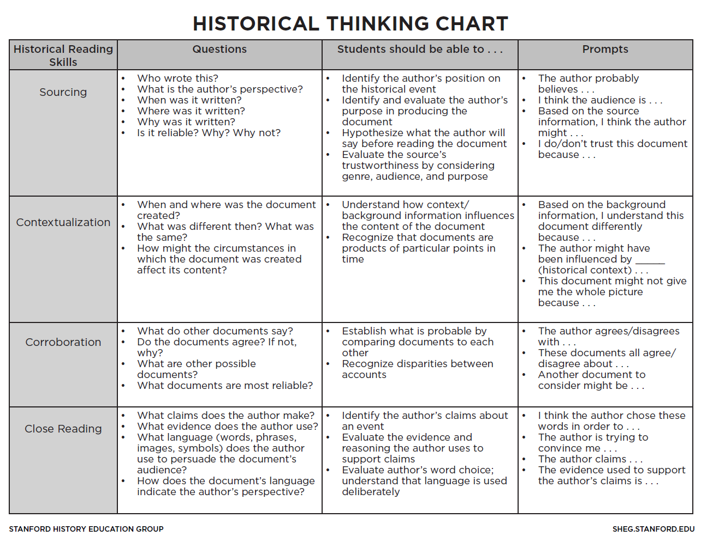
Historical Thinking & Analysis Tools

Slide 16
https://tinyurl.com/FCSSLOC2018

Slide 17
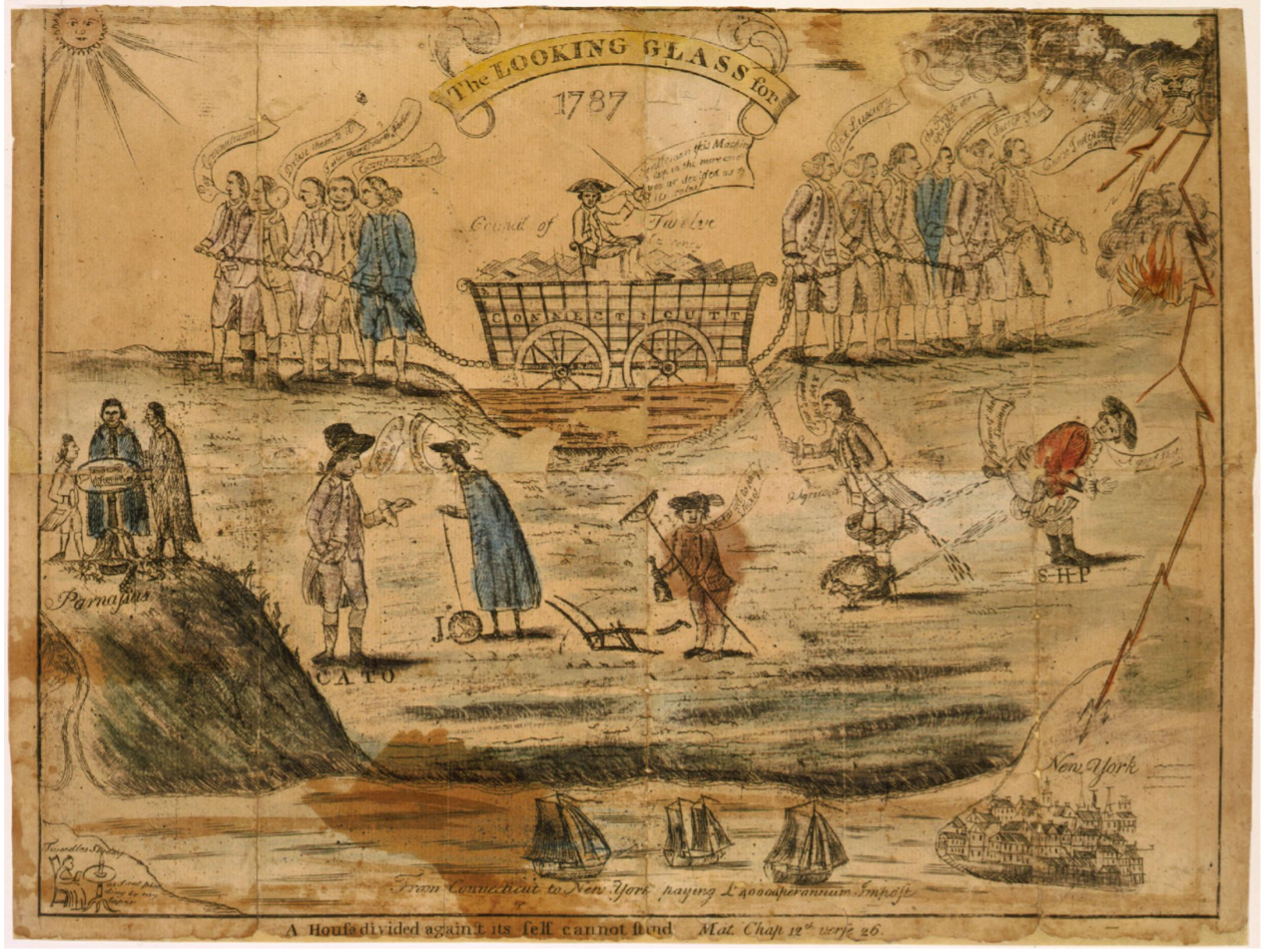
Dive in…
The looking glass for 1787. A house divided against itself cannot stand. Mat. chap. 13th verse 26
A satire touching on some of the major issues in Connecticut politics on the eve of the ratification of the U.S. Constitution. http://www.loc.gov/pictures/item/2008661778/

Slide 18
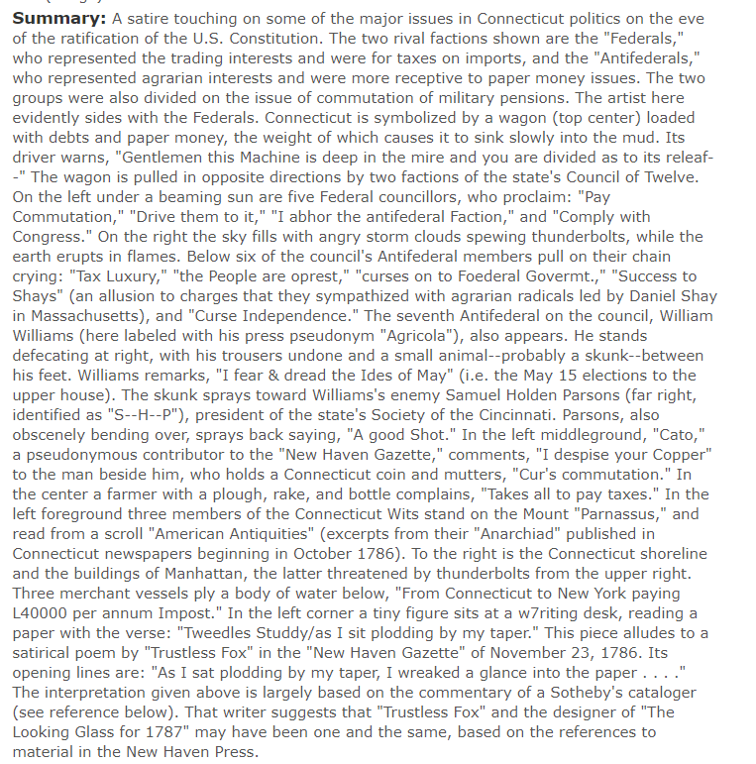

Slide 19
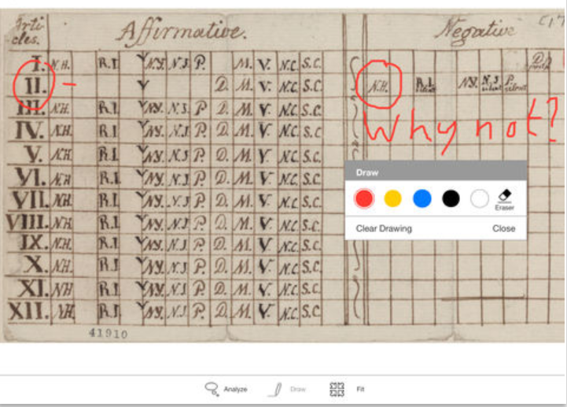
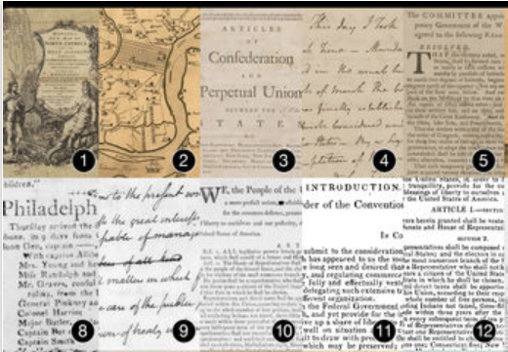
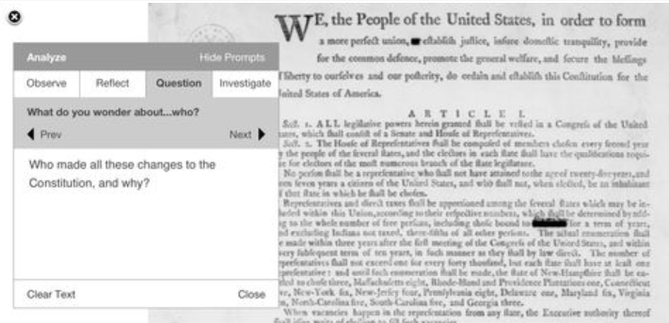
Student Discover Set- FREE ebook (Apple)
Historical artifacts and one-of-a-kind documents from the LOC Primary Source Set collections.
Interactive tools let you zoom in for close examination, draw to highlight interesting details, and make notes about what you discover.
This set is intended for open-ended primary source analysis by students.
Student Discovery Set — free ebook on iBooks

Slide 20
Questions?
https://tinyurl.com/FCSSLOC2018

Slide 21
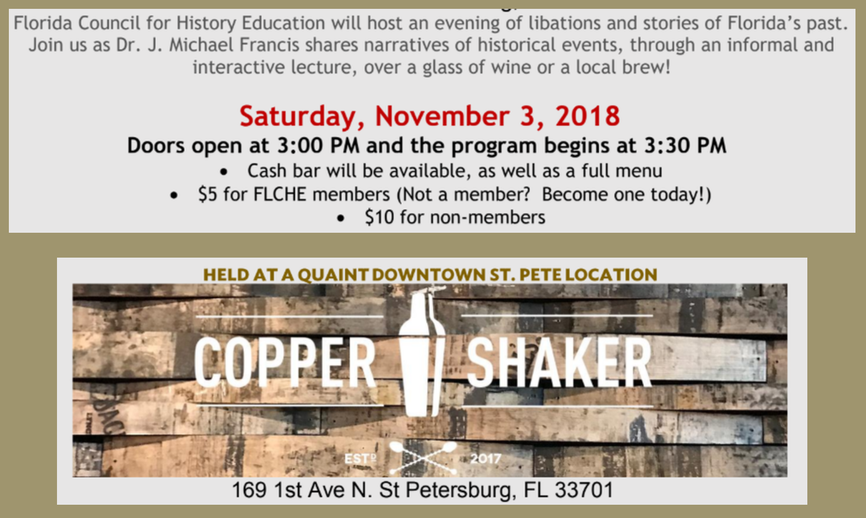
Florida council for history education
http://www.flche.net/
Sip and Scholarship
SAVE THE DATE!
Annual conference August 2nd & 3rd in St. Augustine

Slide 22
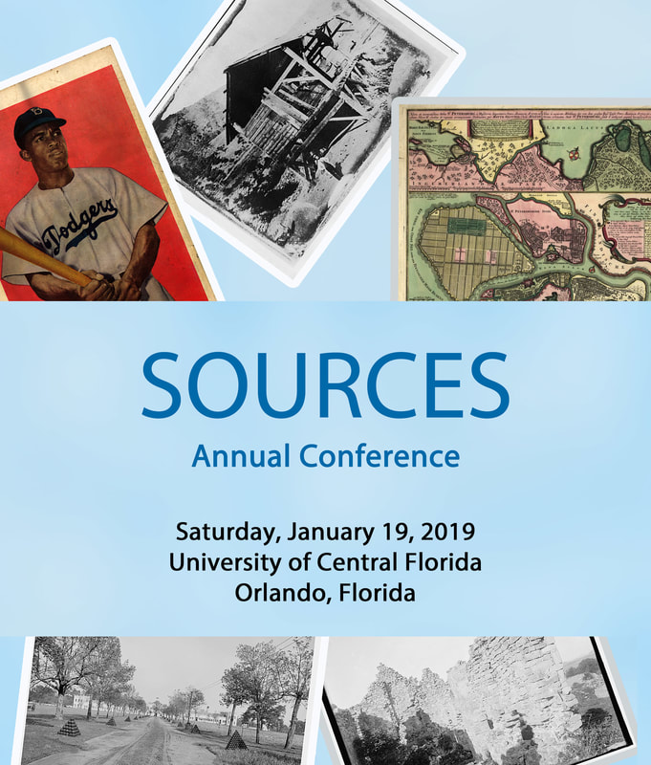
SAVE THE DATE!
SOURCES CONFERENCE Jan. 19th
UCF
SAVE THE DATE!
Engaging Congress
Feb. 8th
UCF

Slide 23
THANK YOU!
https://tinyurl.com/FCSSLOC2018
carollavallee@flche.net
tammarapurdin@flche.net

